Slide 1

The effect of inflation in New Zealand
Data analysis and intelligence

Slide 2
Inflation is a rise in prices, which can be translated as the decline of purchasing power over time.

Slide 3
Hypothesis & Question
How can a large organisation run without breaking its primary integrity towards society? Will this system affect the major population in New Zealand? Is the company willing to take risk for a different form of system?
H0: The company will run on its USUAL form of system along with the major crisis in economy.
H1: The company will run on a DIFFERENT form of system along with the major crisis in economy.

Slide 4
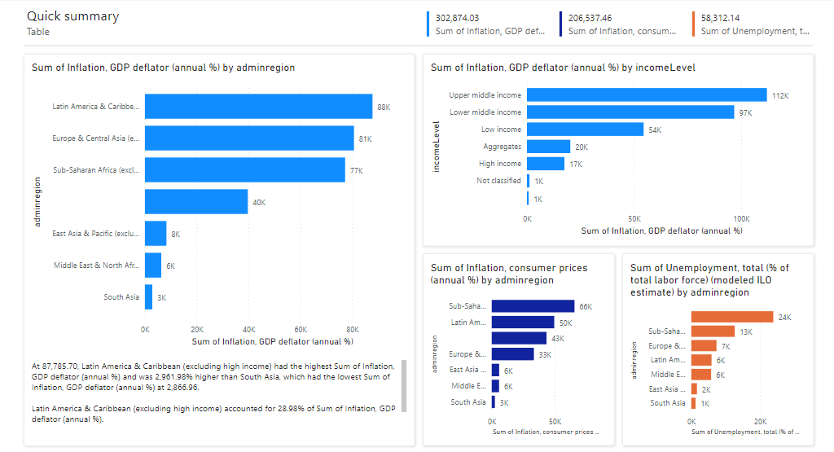

Slide 5
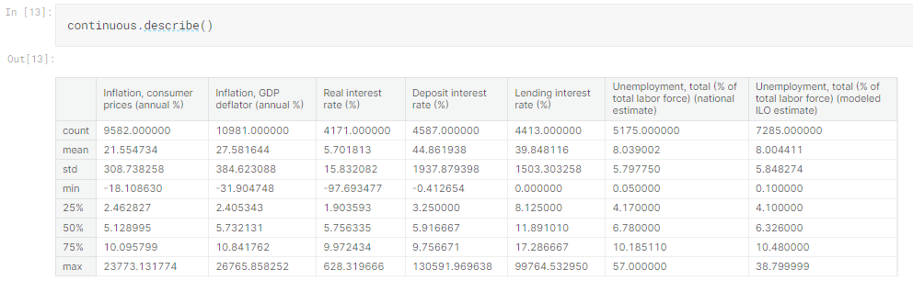

Slide 6
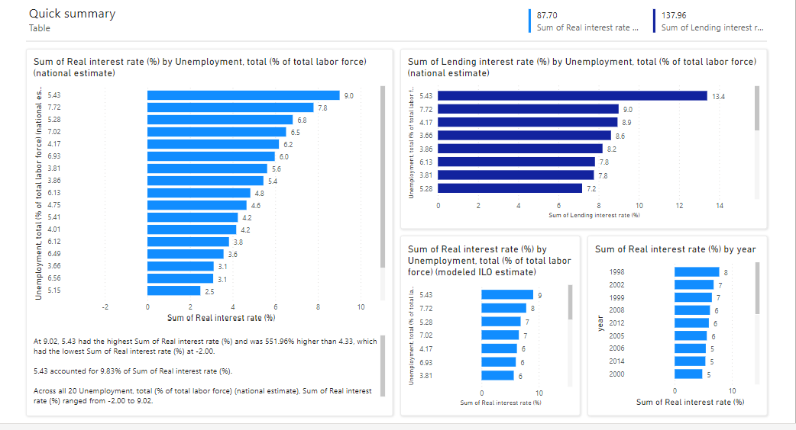

Slide 7
Big business in New Zealand
FoodStuff NZ is one of the biggest businesses in New Zealand it operates a number of supermarket chains across the country.
As one of the leading companies that operates in New Zealand we can assume that there are setbacks in terms of running the company.
Inflation is one of the leading factors that highly affects a country’s economy and New Zealand is not an exception in this kind of crisis.

Slide 8
Inflation: Towards the people
According to stats.gov.nz (A national government-based statistical agency that is responsible for collecting and analyzing data exclusively in New Zealand)
As of March 2023 there is a 6.7 increase in the consumers price index (CPI). Compared this percentage back in 2012 and 2019, we can observed that increase was significantly high.

Slide 9
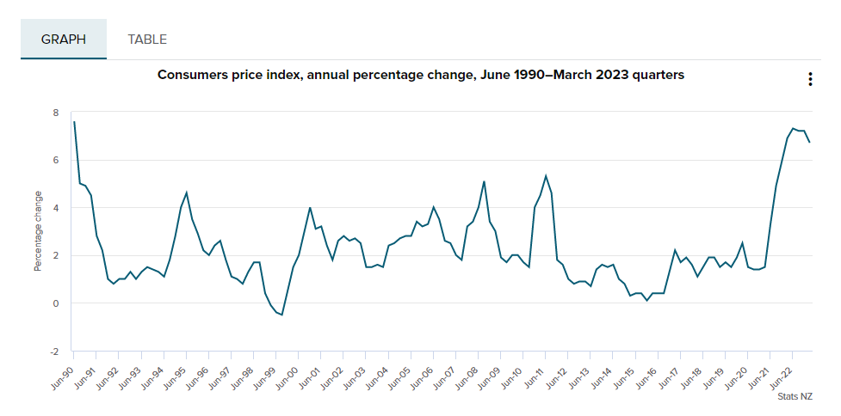
New Zealand: CPI or Inflation graph

Slide 10
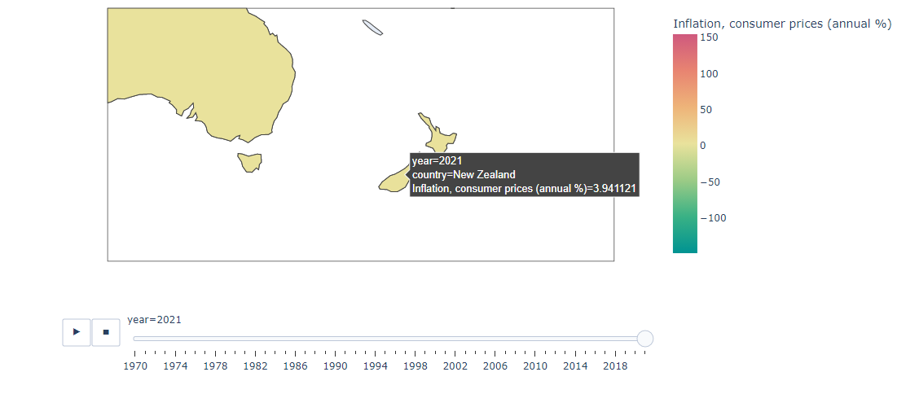

Slide 11
Effects: Towards the people
We have to understand that this organisation is a reliable source of food and supplies which means that we can’t ignore the people that are also relying on these supermarket chains around New Zealand.
One of the major impact that greatly affects the people, are the consumer prices that is also increasing proportionally with the rate of inflation.

Slide 12
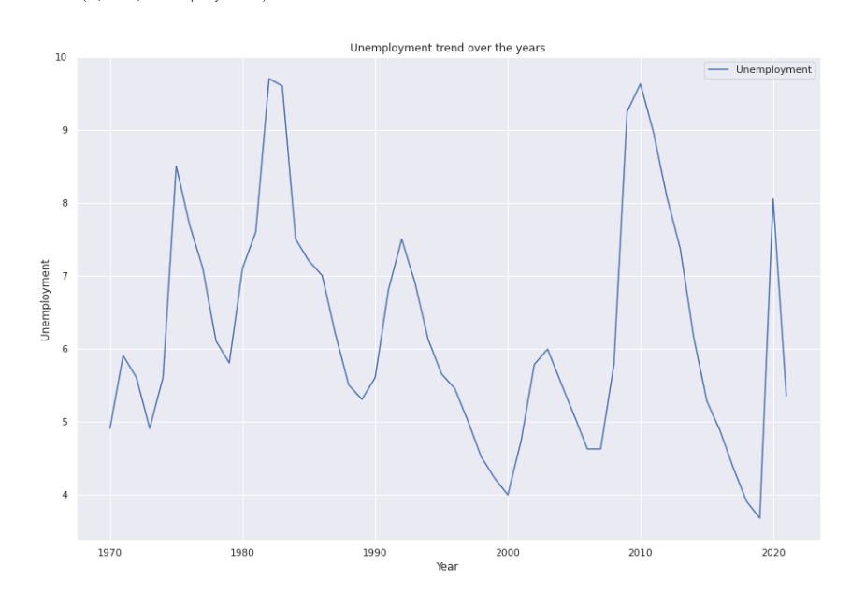
Graph

Slide 13
Effects: Towards the people
Unemployment will increase
Prices of foods and supplies will also increase
Businesses will be forced to raise wages

Slide 14
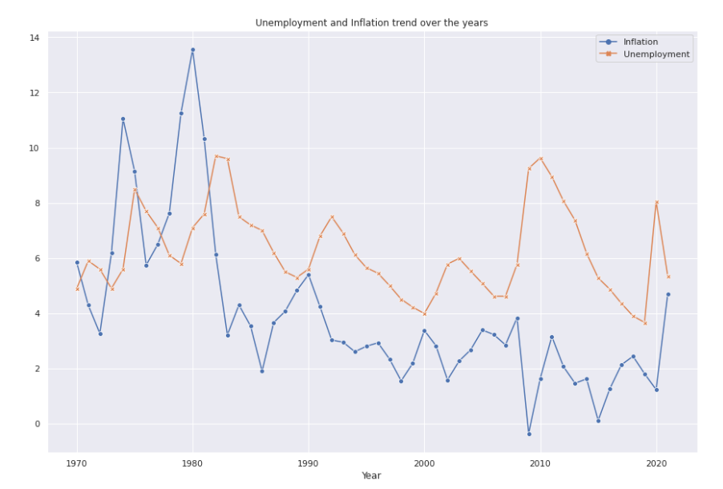
Graph

Slide 15
Inflation: Foodstuff NZ
There are several data that can potentially be used to develop good insights to deal with inflation.
Foodstuff NZ provided several changes that happened during the increase of inflation from last year (2022)
The business starts to cut off hours from the workers
The business starts to reduce people
Increase of wage
Based on stats NZ as of June 2022 there is an increase of LCI or Labour Cost Index about 3.4 percent (Annually)
An increase of 6.4 percent for the average ordinary time (hourly)

Slide 16
Data
“Supplier costs continue to increase, although momentum in the cost increases to supermarkets has eased compared with 2022. The Infometrics-Foodstuffs New Zealand Grocery Supplier Cost Index (GSCI) shows an 8.8%pa increase in what suppliers charged supermarkets for goods in May 2023.”
("Media release: Cost increases from grocery suppliers to supermarkets increase 8.8% in may," 2023)

Slide 17
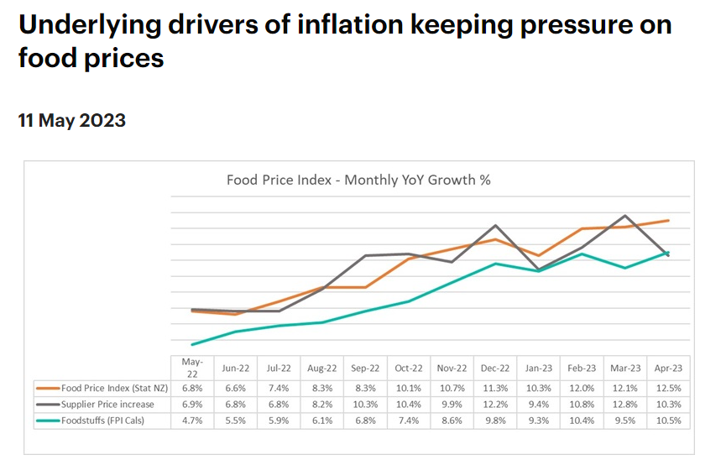

Slide 18
Conclusion
Based on the information that I have gathered there are no accurate numbers in terms of confidence that could help me justify my hypothesis.
But using the information that was published by a legitimate company such as stats NZ, I have to acknowledge the null hypothesis that the company will run on a DIFFERENT form of system along with the major crisis in economy.
It is expected that there will be a change in the system considering that the world went into a massive pandemic.

Slide 19
Conclusion
We can consider that such big businesses in New Zealand are willing to risk doing a different form of system for the sake of the business to continue running.
example:
The supermarket are one of the industries that was allowed to be open during the pandemic.
Inflation heavily affected most of the population in New Zealand
Unemployment
CPI

Slide 20
Thank you

Slide 21
References
Annual inflation 6.7 percent | Stats NZ. (2023, April 20). Home | Stats NZ. https://stats.govt.nz/news/annual-inflation-6-7-percent/
(2022). Annual Reports. https://annualreports.foodstuffs.co.nz
Annual wage inflation rises to 3.4 percent | Stats NZ. (2022, August 3). Home | Stats NZ. https://www.stats.govt.nz/news/annual-wage-inflation-rises-to-3-4-percent
FSNI fact checker. (2022, May 20). Kia ora, we're Foodies North Island. https://www.foodstuffs.co.nz/news-room/fsni-fact-checker
Media release: Cost increases from grocery suppliers to supermarkets increase 8.8% in may. (2023, June 12). Infometrics. https://www.infometrics.co.nz/article/2023-06-mr-grocery-supplier-cost-index-may-2023
New Zealand inflation rate - 2022 data - 2023 forecast - 1918-2021 historical. (n.d.). TRADING ECONOMICS | 20 million INDICATORS FROM 196 COUNTRIES. https://tradingeconomics.com/new-zealand/inflation-cpi
Underlying drivers of inflation keeping pressure on food prices. (2023, May 11). Kia ora, we're Foodies North Island. https://www.foodstuffs.co.nz/news-room/2023/Underlying-drivers-of-inflation-keeping-pressure-on-food-prices
What is sustainable business. (n.d.). What is sustainable business. https://www.business.govt.nz/getting-started/business-planning-tools-and-tips/what-is-sustainable-business/

